Slide 1
Lesson #7
Making Decisions!

Slide 2
Do you remember the Turing Machine?
It has…
2 instructions
2 decisions

Slide 3
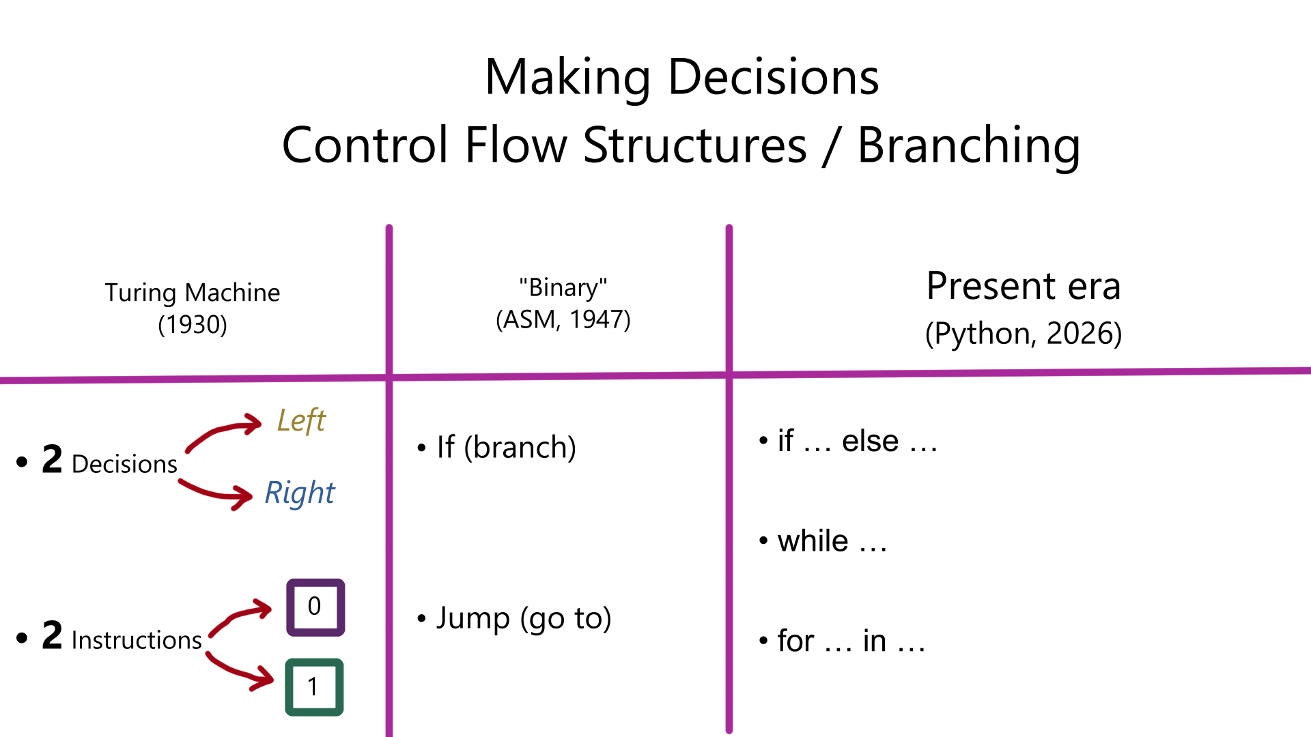

Slide 4
If (branch)

Slide 5
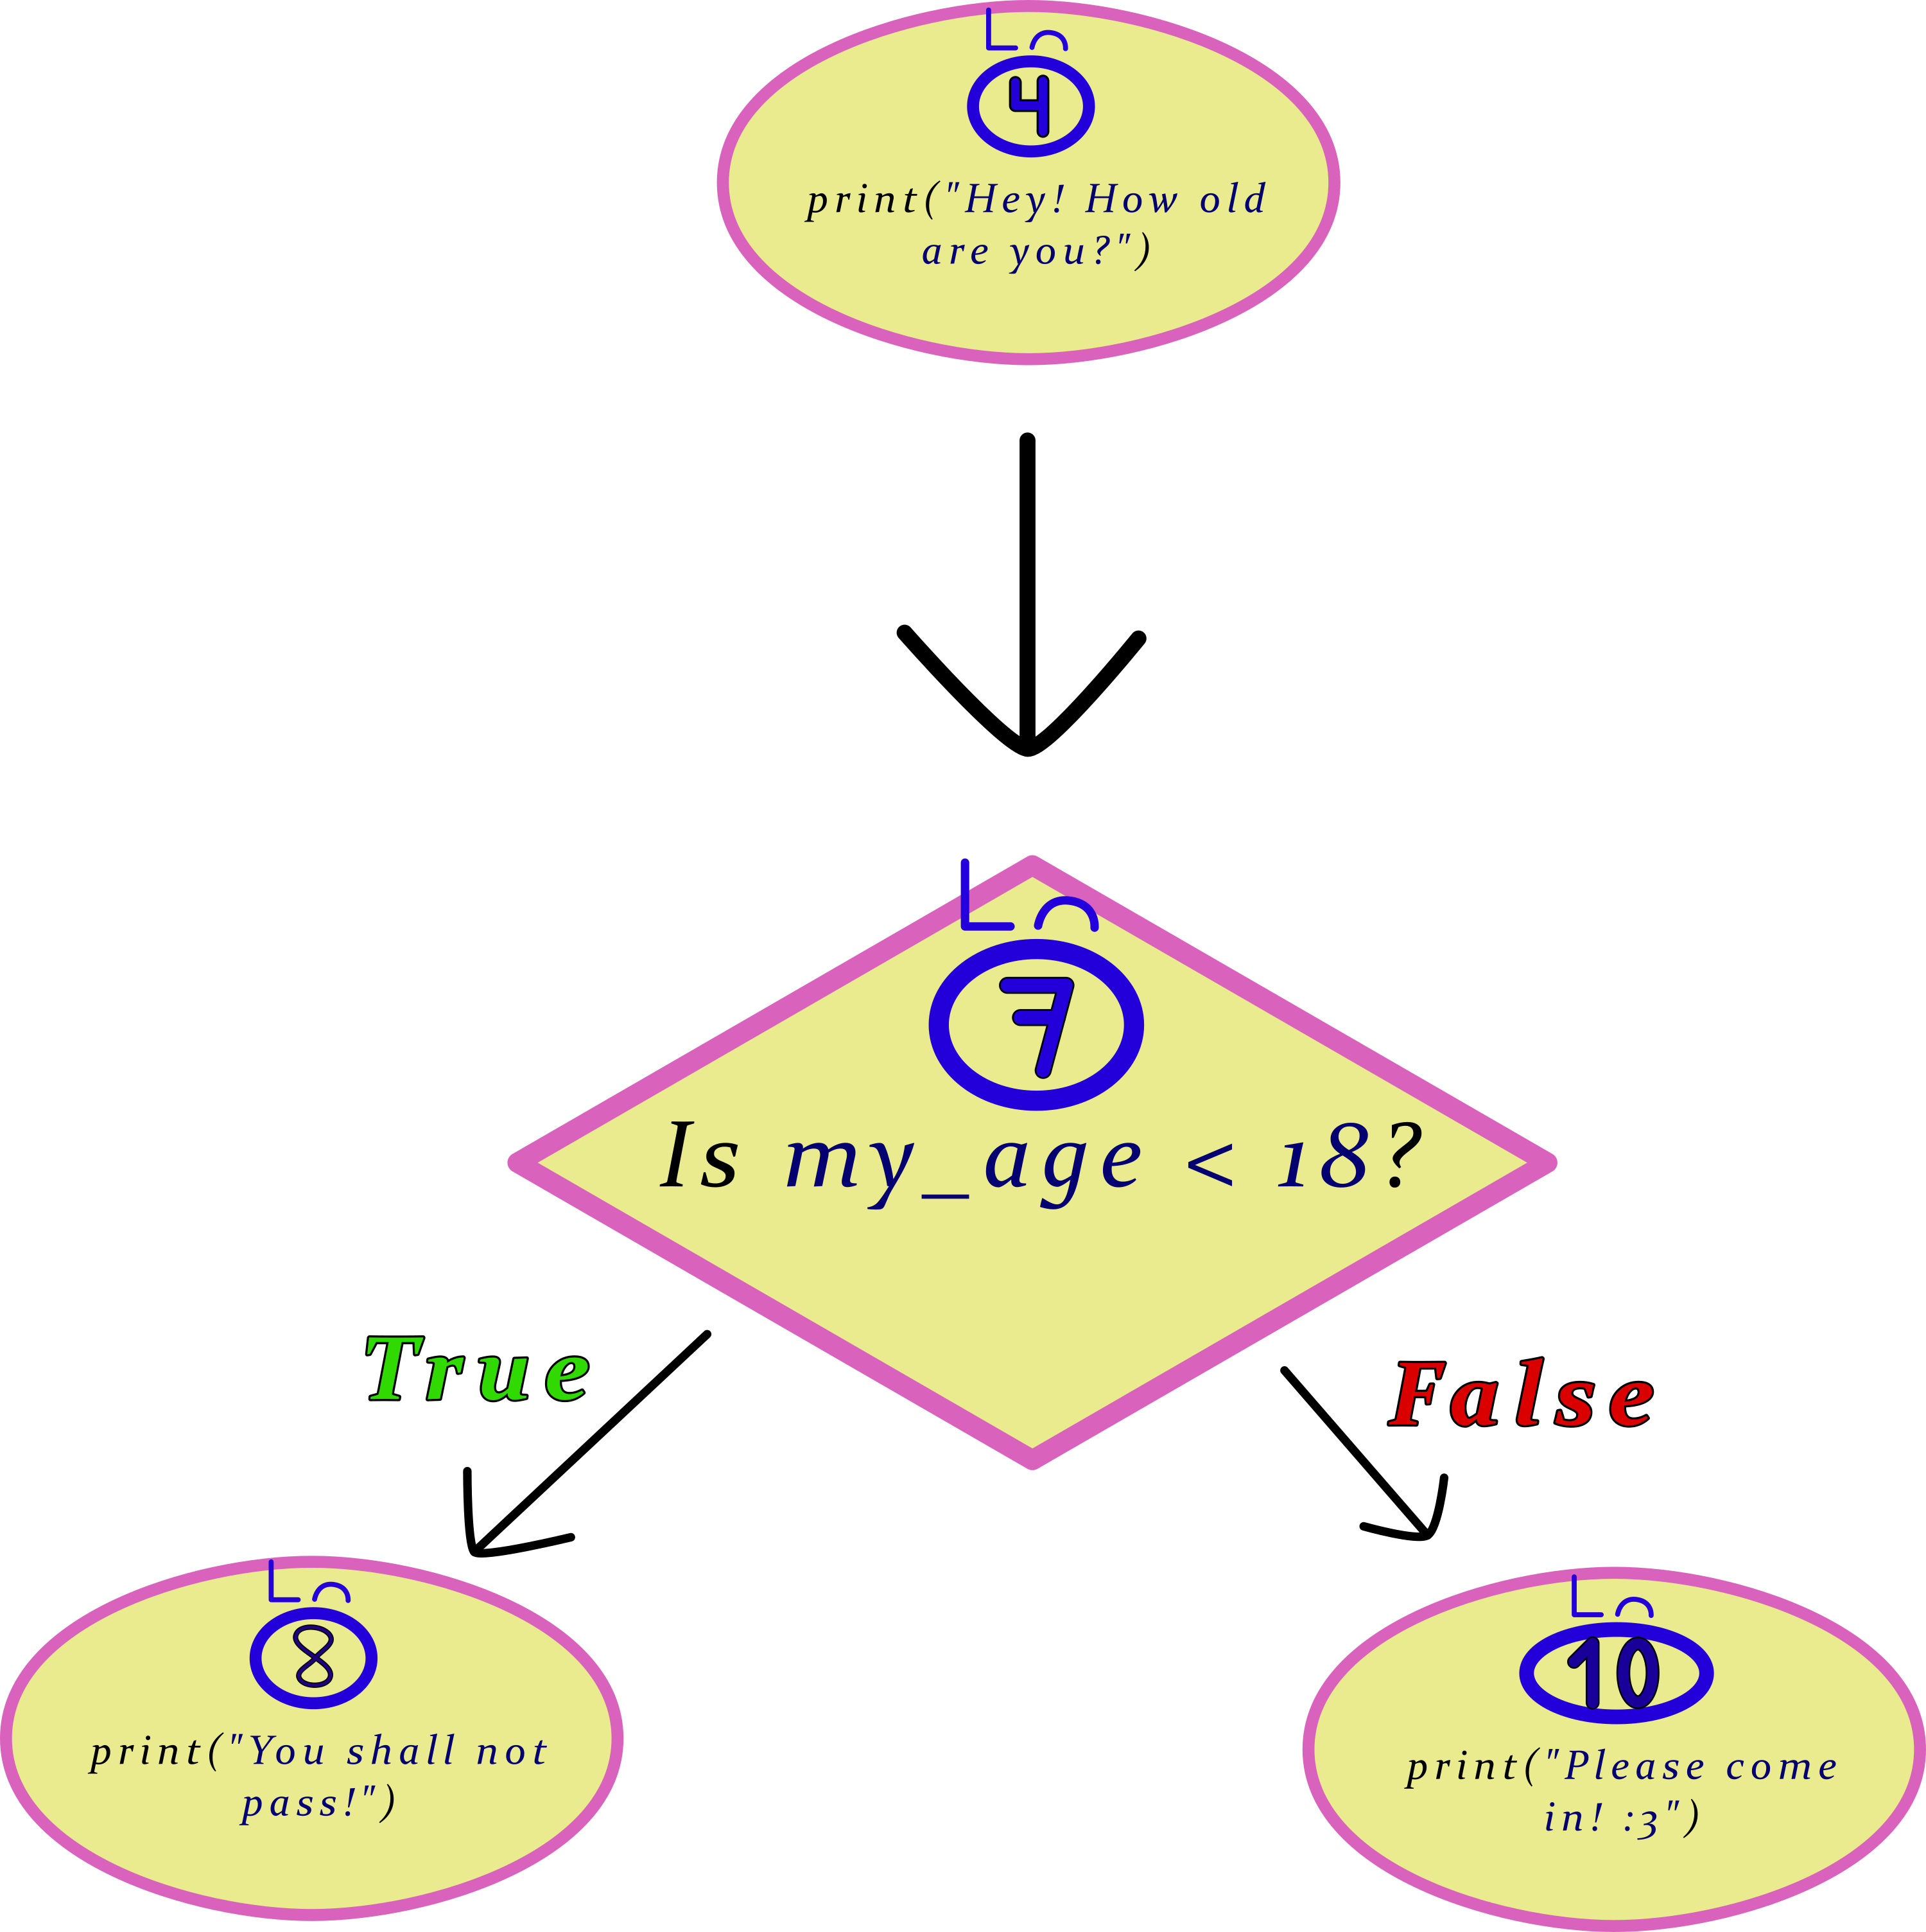
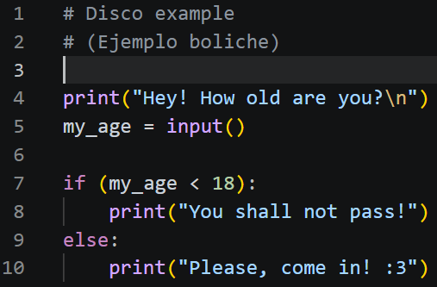
If (branch)

Slide 6
While (loop)

Slide 7
For (loop)

